Slide 1

Retrieving and Classifying Affective Images
via Deep Metric Learning
Jufeng Yang¹, Dongyu She¹, Yu-Kun Lai², Ming-Hsuan Yang³
杨巨峰，折栋宇(sherry6656@163.com)，来煜坤，杨明玄
¹ College of Computer and Control Engineering, Nankai University
² School of Computer Science and Informatics, Cardiff University
³ School of Engineering, University of California, Merced, USA
Notes:
Welcome everyone
I’m dongyu she from nankai university
This is a joint work with my supervisor prof, jufeng yang with nankai university
Professor yu-kun lai with cardiff university
Professor ming-husan yang

Slide 2
Outline
Introduction
Deep metric learning framework
Experiment Result
Conclusion

Slide 3

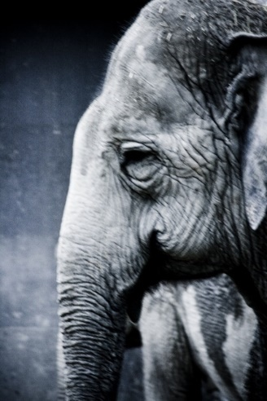

Introduction
“A picture is worth a thousand words.”
Sentiment
A person's disposition to respond to visual inputs
There are three constituents of sentiment
Subject experience: individual's self-perception
External behavior: the physical part of reaction
Physical arousal: the emotional response given stimuli

Slide 4

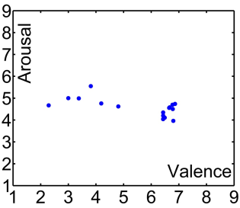
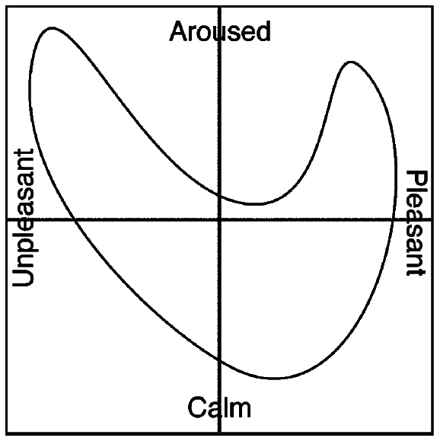
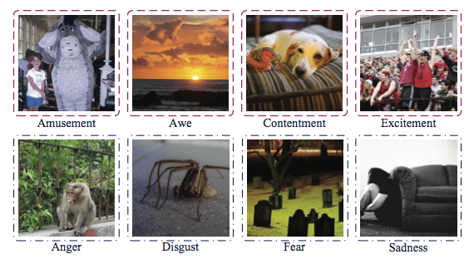
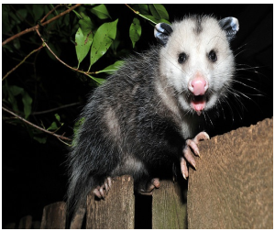
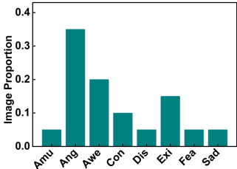
Modeling Sentiment
Dimensional space
Valence (the level of pleasure)
Arousal (intensity of the experience)
Dominance (the degree of control)
Arousal
Categorical states
Positive, negative, neutral
Mikel’s eight emotion
Ekman’s six emotion
CPD
Distribution model
Continuous probability distribution (CPD)
Discrete probability distribution (DPD)
DPD
Valence
Machajdik et al. Affective Image Classiﬁcation using Features Inspired by Psychology and Art Theory (MM’10)
Yang et al. Learning Visual Sentiment Distributions via Augmented Conditional Probability Neural Network (AAAI’17)

Slide 5
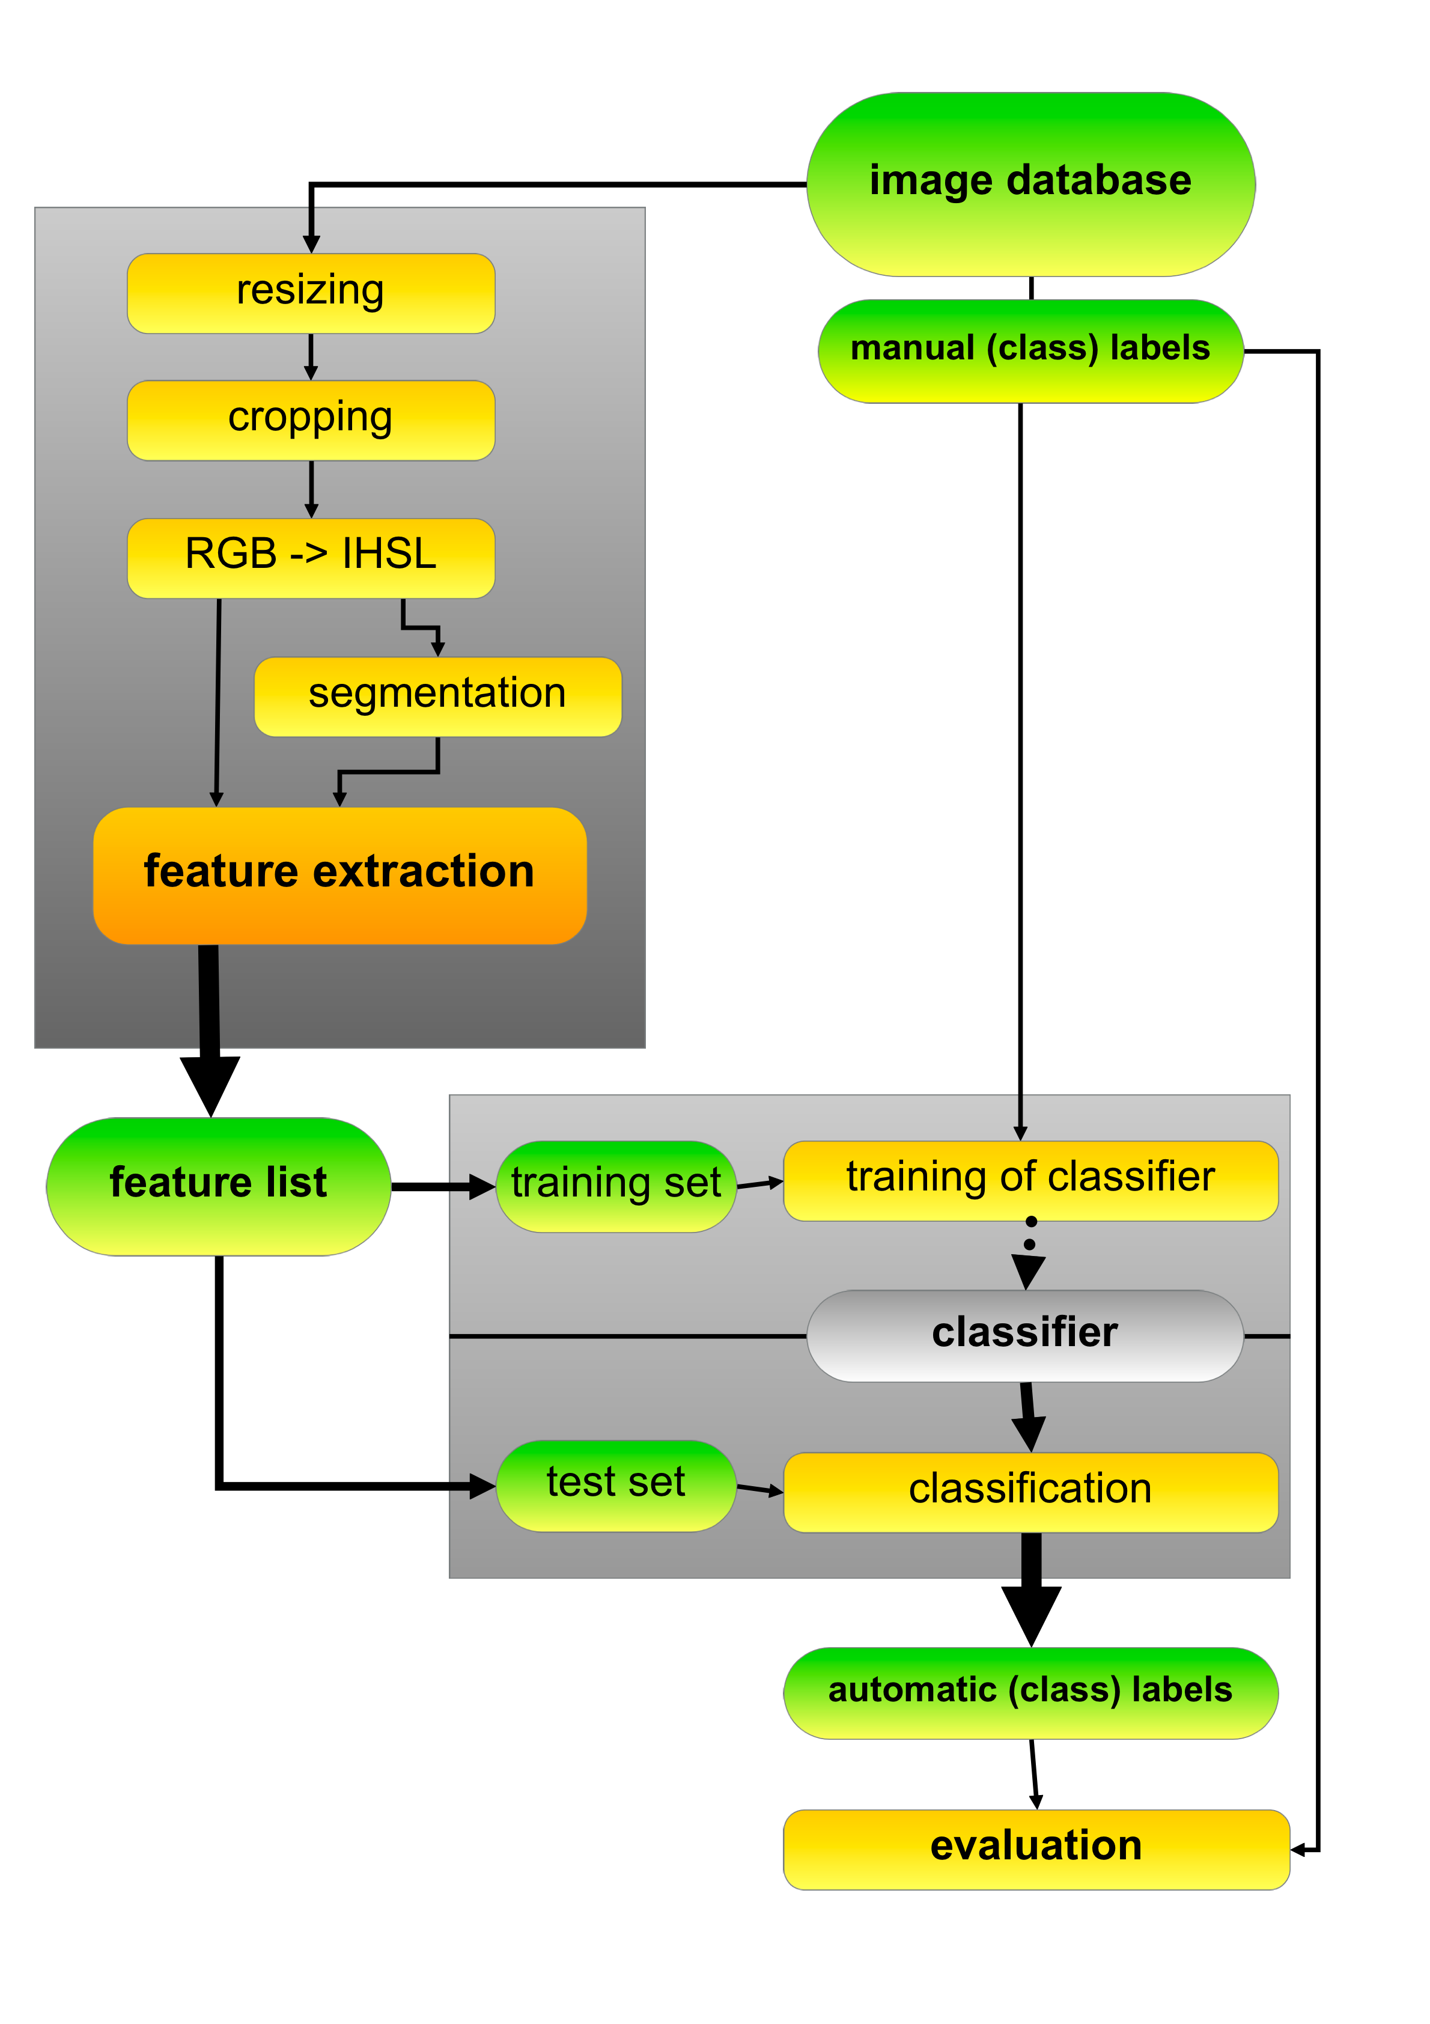
Current Algorithm
Numerous methods on the affective image classification and retrieval need multiple stages.
Low-level feature inspired by psychology and art theory
Mid-level feature based on the visual concept
Recent CNN methods aim to distinguish sentiment in a discrete label space
fail to consider the relations between different emotional categories
Machajdik et al. Affective Image Classiﬁcation using Features Inspired by Psychology and Art Theory (MM’10)
Borth et al. Large-scale visual sentiment ontology and detectors using adjective noun pairs (MM’13)
You et al. Robust image sentiment analysis using progressively trained and domain transferred deep networks (AAAI’15)

Slide 6
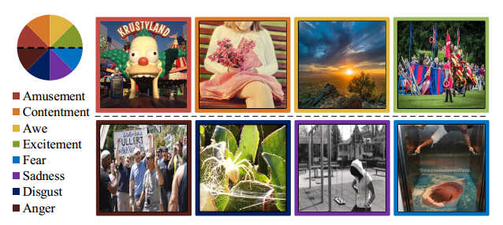
Motivation
Different from the conventional vision tasks, affective image understanding is ambiguous for two main reasons
Subjectivity: sentiments are not semantically independent of each other, while the existing studies use the discrete label space.
Complexity: fully-connected layers in CNN distinguishing high-level semantic contents are insufficient to characterize sentiment
You et al. Building a Large Scale Dataset for Image Emotion Recognition (AAAI’16)

Slide 7
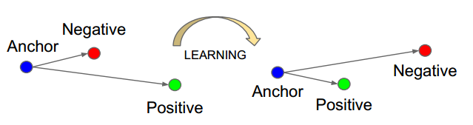
Metric learning
Metric learning is to separate inter-class embedding and reduce the intra-class variance.
Traditional metric learning methods focus on learning a Mahalanobis distance in Euclidean space or high dimensional kernel space
Deep metric learning methods learn feature representation by the guide of metric based losses, e.g. triplet loss
Weinberger et al. Distance metric learning for large margin nearest neighbor classification (NIPS’05)
Elad Hoffer, Nir Ailon. Deep Metric Learning using Triplet Network (ICLR’15)

Slide 8
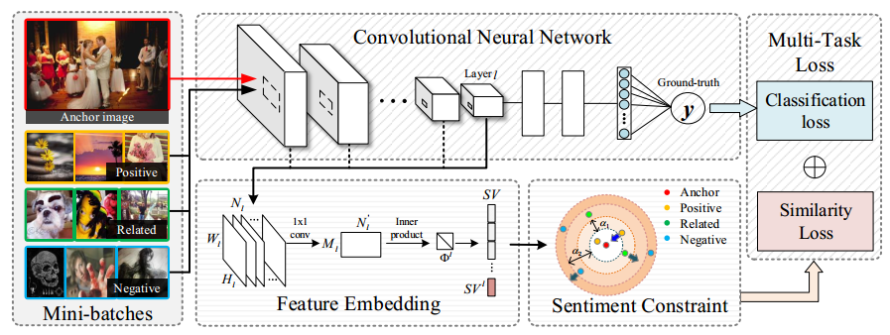
Framework Overview
We address the problems by a multi-task framework to simultaneously optimize the classification and retrieval tasks.

Slide 9
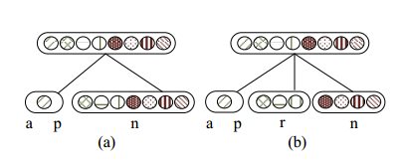
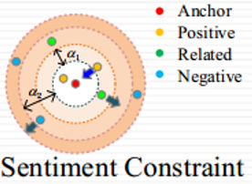
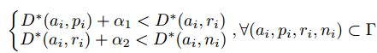
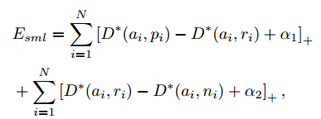
Sentiment Constraint
We generalize the triplet constraint to the sentiment constraint taking emotion relationships into consideration.
With a weak form of prior knowledge, the sentiment metric can be learned by minimizing the sentiment loss function:
triplet constraint
sentiment constraint

Slide 10
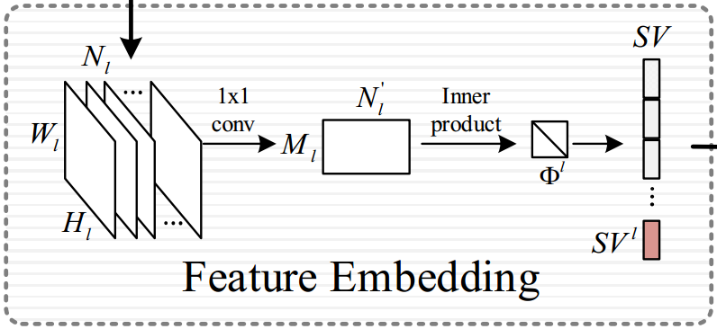
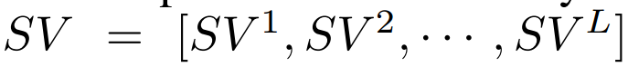
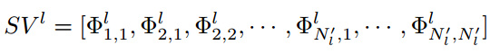
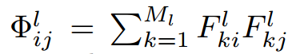
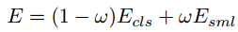
Sentiment Vector
We utilize deep representations and propose the sentiment vector consisting of multiple Gram layers, each of which computes inner products of filter responses in a convolutional layer.
Thus, we explicitly train the deep model to optimize the classification and similarity constraints with the multi-task loss:

Slide 11
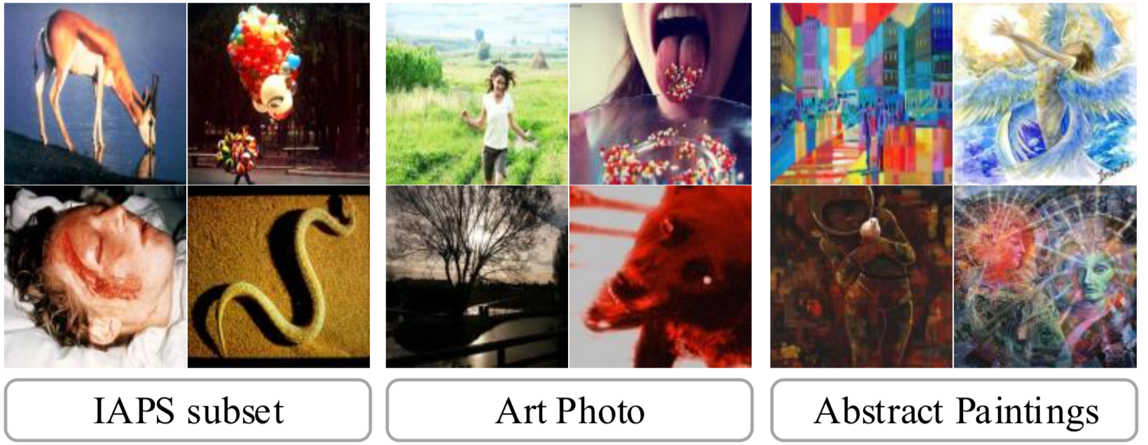

Experiment
Dataset
Evaluation
Classification: accuracy
Retrieval: NN, FT, ST, DCG, ANMRR, mAP₈, mAP₂
Scale | Dataset | ImageNum | ClassNum
Small-scale | IAPSa | 395 | 8
 | ArtPhoto | 806 | 8
 | Abstract Paintings | 228 | 8
Large-scale | Flickr&Instagram | 23,308 | 8
Flickr&Instagram

Slide 12
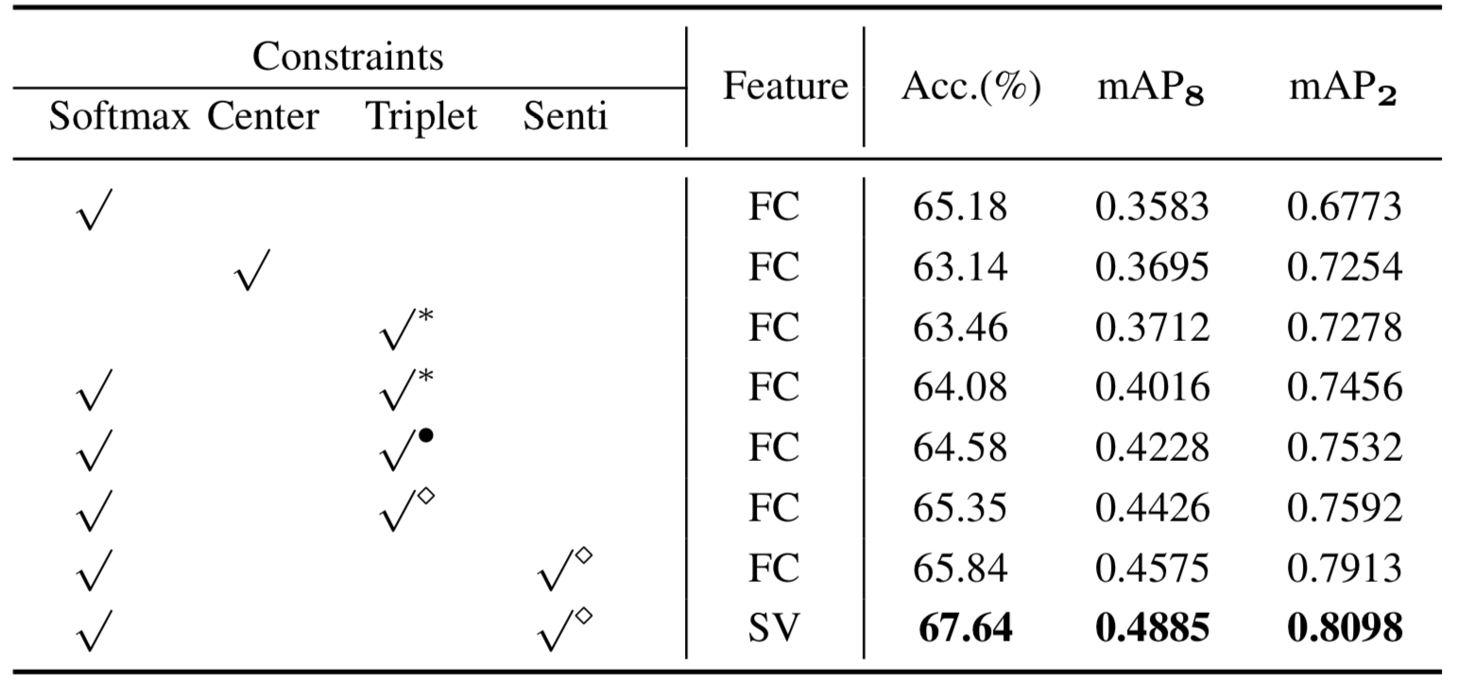
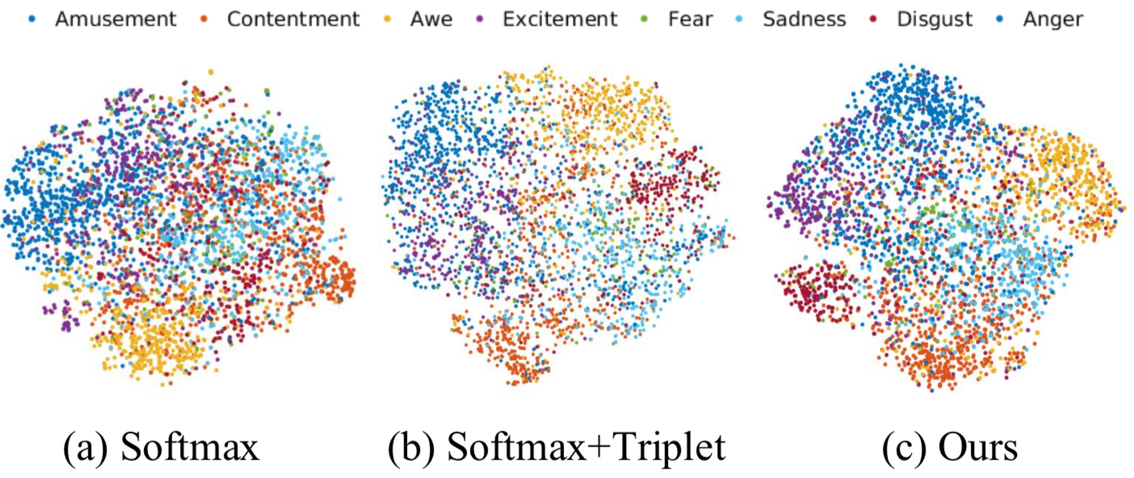
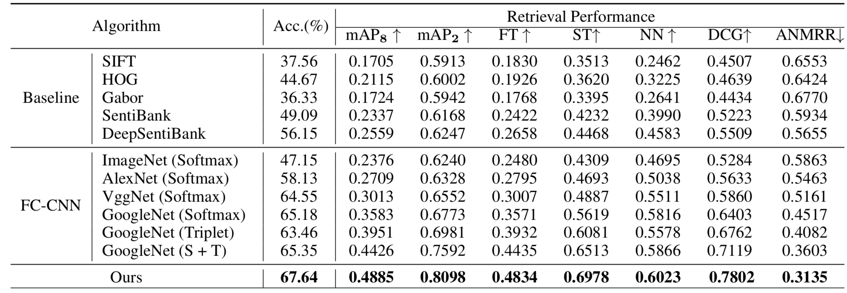
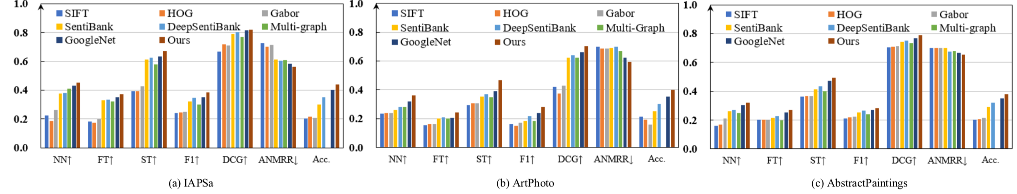
Experiment Result
Classification and retrieval performance on the FI dataset
Performance on the small-scale datasets with transfer learning

Slide 13
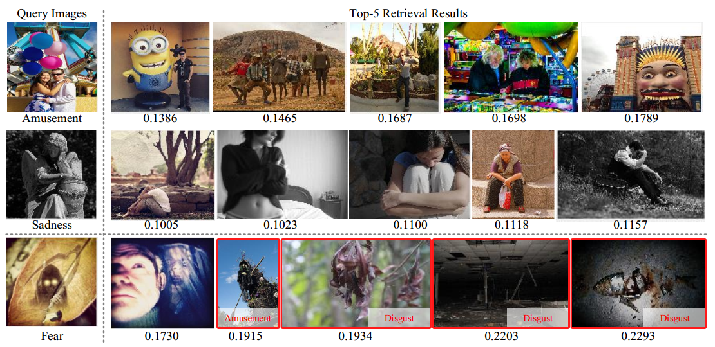
Retrieval Results

Slide 14
Conclusion
This work propose a unified framework to address the retrieval and classification goals simultaneously.
Main contribution
We propose the sentiment constraint generalized from the triplet constraint to incorporate the relation of emotional categories to the CNN learning process
We propose the sentiment vector to measure the difference between affective images, which captures the texture information from multiple convolutional layers

Slide 15

THANKS!
Q&A

